Slide 1

Business Environment and Strategic Tools
Understanding the Dynamic World of Businesses
Presented by: Rijul Chaturvedi
Course: Essentials of Business Management
JK Laxmipat University

Slide 2
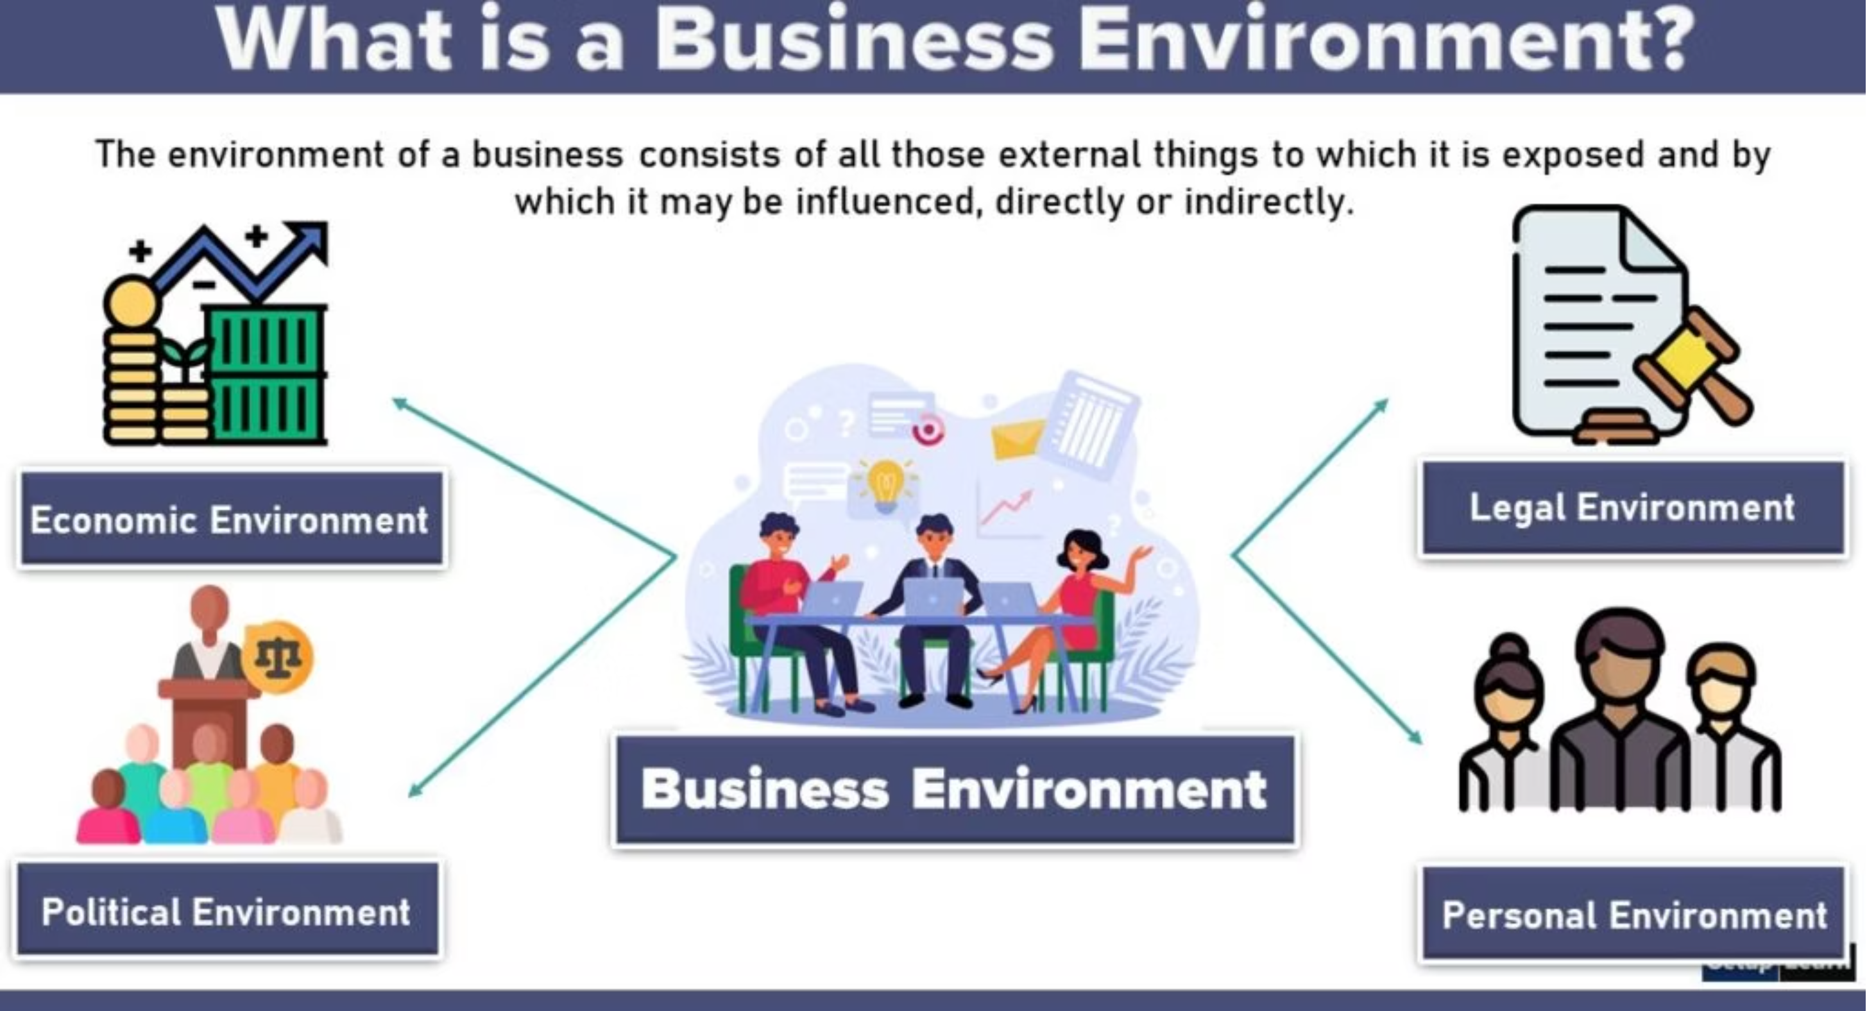

Slide 3
Business Environment
The business environment encompasses all external and internal factors that influence a business's operations, decisions, and performance. Understanding these elements is crucial for effective management and strategic planning.
Internal Environment
External Environment
Factors within the organization's control, such as organizational culture, resources (financial, human, physical), and internal processes. These shape a company's capabilities and competitive advantages.
Factors outside the organization's direct control, divided into micro (customers, competitors, suppliers) and macro (economic, social, political, technological, legal, ecological) environments. These present opportunities and threats.
For managers, this understanding isn't academic; it's essential for anticipating changes, mitigating risks, and capitalizing on emerging trends to sustain growth and competitiveness.

Slide 4
Dimensions of the Business Environment: PESTLE Analysis
The external macro-environment can be systematically analyzed using the PESTLE framework, which categorizes various influences. Each dimension plays a significant role in shaping strategic decisions.
Political: Government policies, trade regulations, taxation. Example: Recent tariffs on imported goods impacting manufacturing costs.
Technological: Innovation, R&D, automation, digital disruption. Example: Advances in AI revolutionizing customer service operations.
Economic: Inflation rates, interest rates, consumer spending power. Example: Rising interest rates increasing borrowing costs for business expansion.
Legal: Employment laws, health and safety regulations, consumer protection. Example: New data privacy laws (e.g., GDPR) requiring significant compliance efforts.
Social: Demographics, cultural trends, lifestyle changes. Example: Growing consumer preference for sustainable products driving new market segments.
Ecological: Environmental protection, resource scarcity, climate change. Example: Increased regulations on carbon emissions impacting logistics and supply chains.

Slide 5
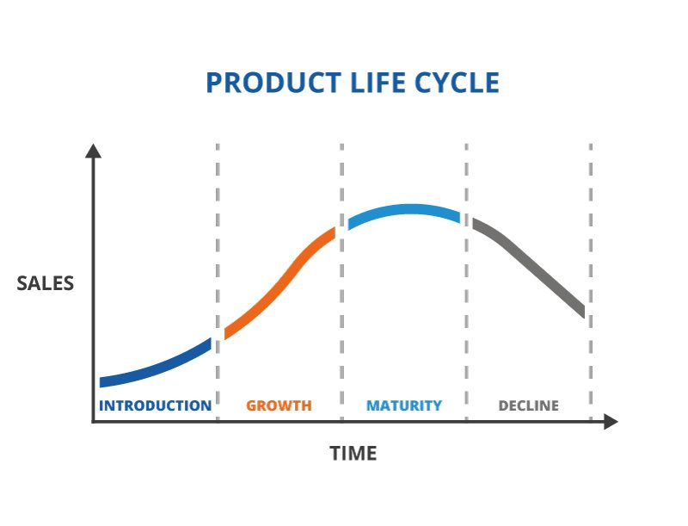
Reducing Product Life Cycle
Increasing Expectation
High uncertainty
Global impact

Slide 6

What is the way out ?
Innovation
Cost
China
Cost-effective Product Quality
Japan
Quality

Slide 7



Innovation and creativity
Innovation is the specific tool of entrepreneurs by which they exploit change as an opportunity for a different business or a different service
- Peter F Drucker
Clean India
Demonetization
Corruption
Establishing a business through innovation.
Intelligence
Skilled Force
Management
External challenges

Slide 8

3 Is of Innovation
Idea
Implementation
Impact
The execution of the idea can be done in a novel fashion.
What is the difference between Innovation and Invention?

Slide 9
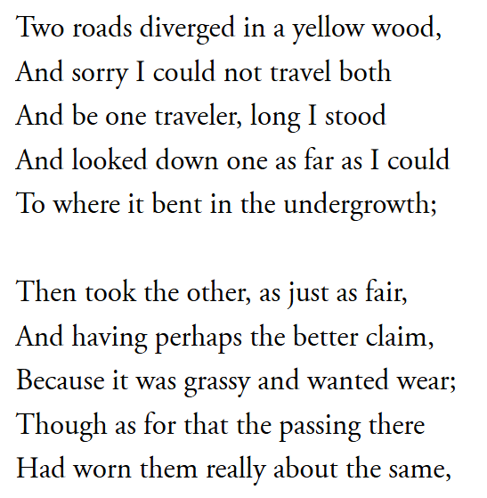
Challenges
Resistance to Change
  Lack of confidence
  Inertia
  Fear of failure
  Ignoring the idea
Prediction Disability
I can not do it
I can do it

Slide 10
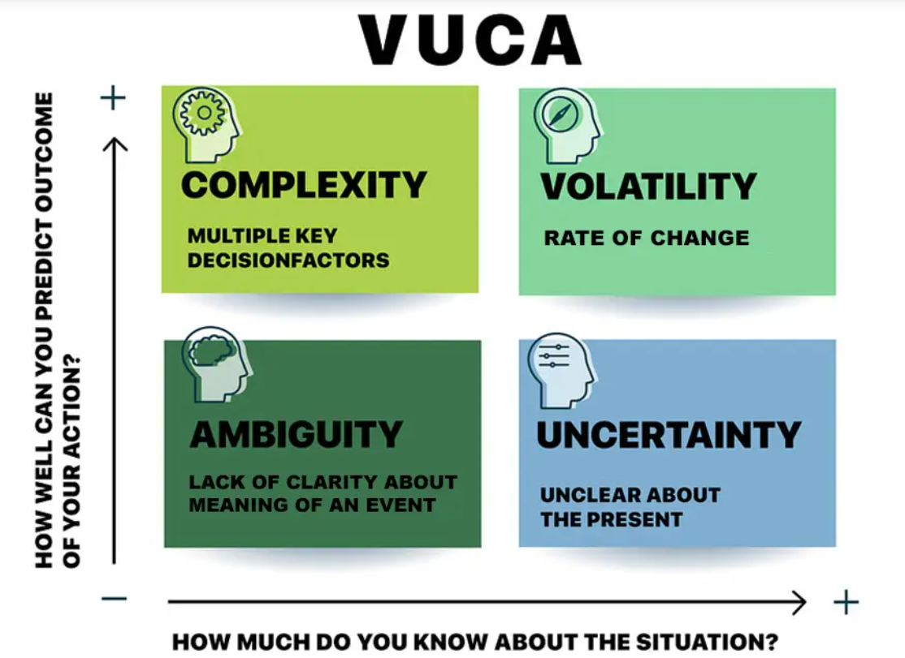
Prediction Disability (VUCA)
Volatility
Uncertainty
Complexity
Ambiguity

Slide 11

Volatility
The challenge is unexpected or unstable and may be of unknown duration, but it’s not necessarily hard to understand; knowledge about it is often available.

Slide 12

Uncertainty
Despite a lack of other information, the event’s basic cause and effect are known. Change is possible but not a given thing.
X= a +by

Slide 13

Complexity
Multiple key decision factors that need to be focused on, simultaneously

Slide 14

Ambiguity
-Causal relationships are completely unclear. No precedents exist; you face “unknown unknowns.”

Slide 15

How to handle the challenges ?
Two distinct systems of thinking
  Emotional and Intuitive
  Deliberations and Analysis

Slide 16
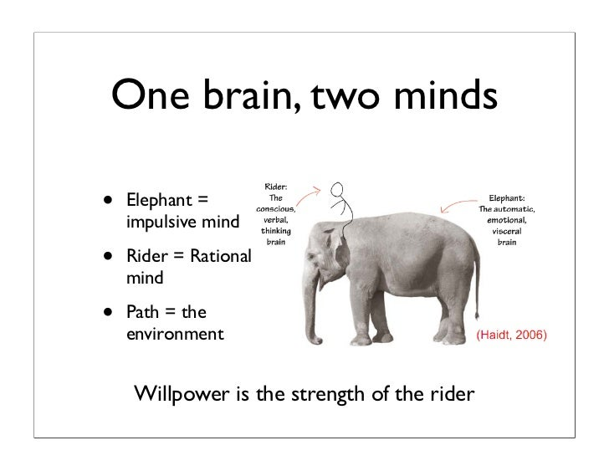
Analogy
Elephant
  Heavy
  Powerful
  Slow Moving
Rider
  Ability to See
  Powerless
  Intelligent

Slide 17


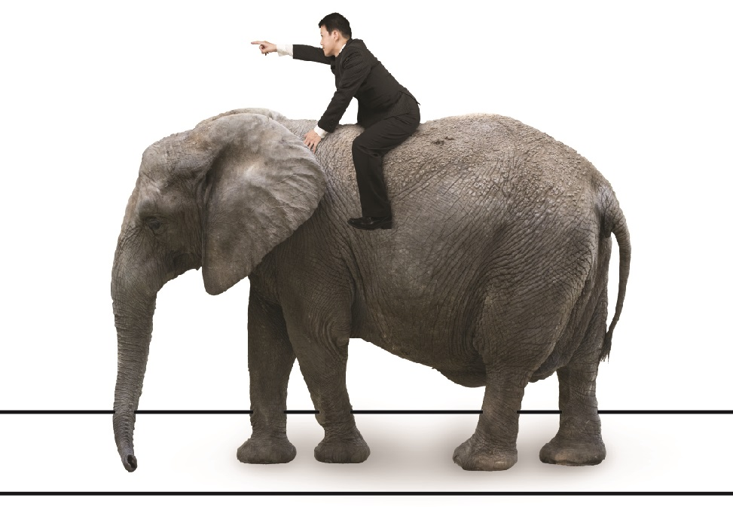




Slide 18

How to deal
A useful resource on VUCA was written by Bob Johansen in 2009. His book, Leaders Make The Future, includes the specific skills, behaviors, and approaches needed to live and control a VUCA environment.
Johansen basically said that we need to:
Counter Volatility with Vision
Meet Uncertainty with Understanding
React to Complexity with Clarity
Fight Ambiguity with Agility

Slide 19
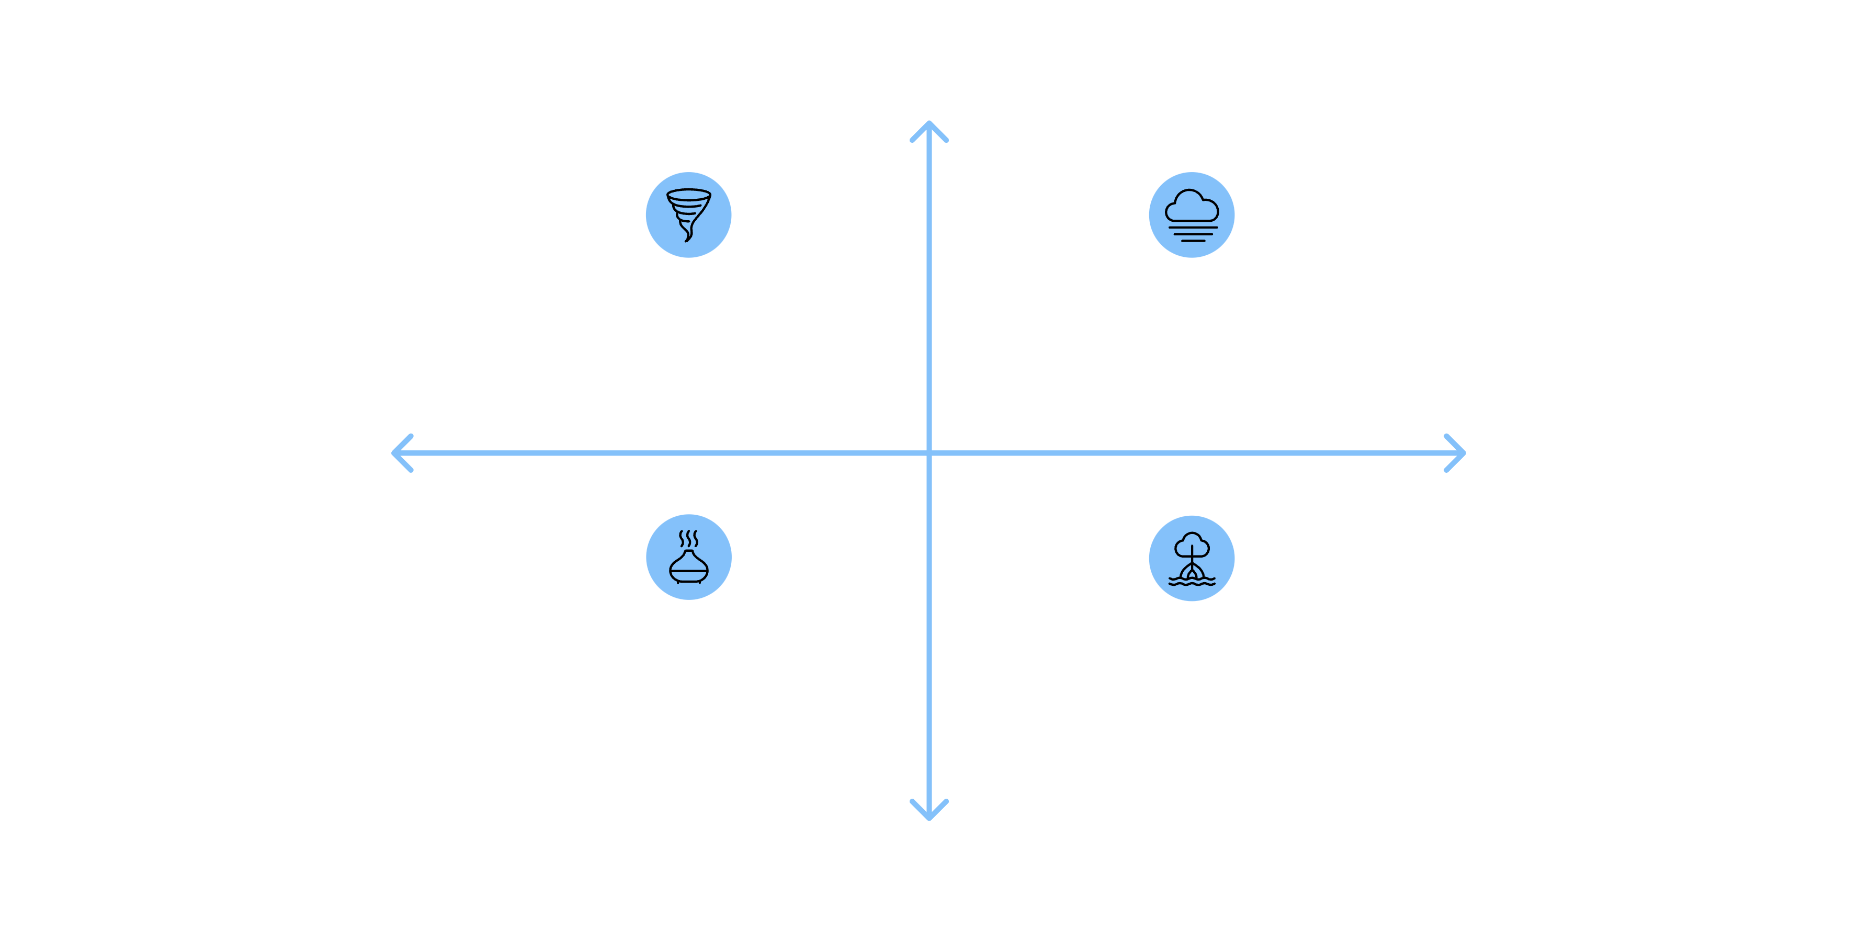




The VUCA Model: Navigating Modern Challenges
Originally coined by the U.S. military to describe the post-Cold War world, VUCA has been widely adopted in business to characterize the increasingly unpredictable and complex global landscape. It highlights four key challenges managers face:
High Change
Volatility — Rapid, unexpected change
Uncertainty — Limited predictability or clarity
High Interdependence
Low Clarity
Ambiguity — Vague signals, multiple interpretations
Complexity — Many interdependent factors
Low Change
Understanding these dimensions is the first step toward developing strategies that thrive, rather than just survive, in dynamic environments.

Slide 20



Business Environment ↔ VUCA: A Dynamic Interplay
Changes in the broader business environment are often the catalysts that create or exacerbate VUCA conditions, forcing organizations to adapt rapidly.
AI Disruption
Global Pandemics (e.g., COVID-19)
Regulatory Changes
Rapid technological advancements create volatility and uncertainty as industries grapple with new competitive landscapes and business models.
New laws or political shifts can introduce ambiguity regarding future compliance requirements and market access, increasing operational complexity.
These events introduce extreme volatility in supply chains, uncertainty in demand, and complexity in operations due to health regulations.
To effectively navigate this interconnectedness, managers require analytical tools like SWOT and TOWS to translate environmental scanning into actionable strategies.

Slide 21
SWOT Analysis: A Core Strategic Tool
SWOT Analysis is a fundamental strategic planning tool used to evaluate a company's Strengths, Weaknesses, Opportunities, and Threats. It provides a structured way to assess both internal capabilities and external factors.
Internal Focus
External Focus
Strengths: Internal attributes and resources that help the company achieve its objectives (e.g., strong brand reputation, patented technology, skilled workforce).
Opportunities: Favorable external factors that a company can exploit for its advantage (e.g., emerging markets, technological breakthroughs, competitor weaknesses).
Weaknesses: Internal limitations or disadvantages that hinder the company's performance (e.g., outdated technology, lack of capital, poor market research).
Threats: Unfavorable external factors that could pose challenges or harm the company (e.g., new competitors, economic downturns, changing consumer preferences).
Consider Tesla as an example: Strengths (innovative technology, strong brand); Weaknesses (production challenges, high price points); Opportunities (global push for EVs, battery tech advancements); Threats (increased competition, raw material price volatility).

Slide 22
Your Turn: SWOT Analysis Template
Let's practice! For a hypothetical small independent coffee shop opening in a bustling city center, what might some of its SWOT factors be?
Strengths
Opportunities
Unique sourcing relationships
Growth in local remote workforce
Experienced team
Partnerships with local bakeries
...
...
Weaknesses
Threats
Limited marketing budget
Increased competition from chains
Small seating capacity
Rising cost of premium coffee beans
...
...
Think about how internal capabilities meet external possibilities, and vice-versa.

Slide 23
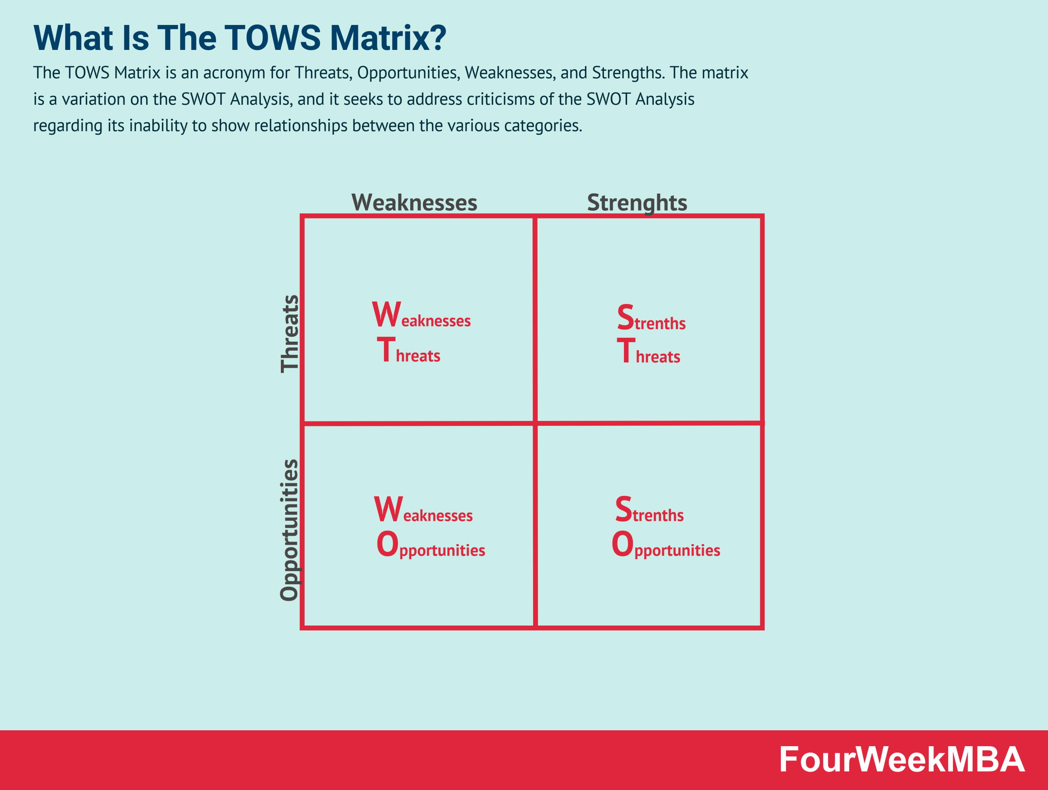

Slide 24
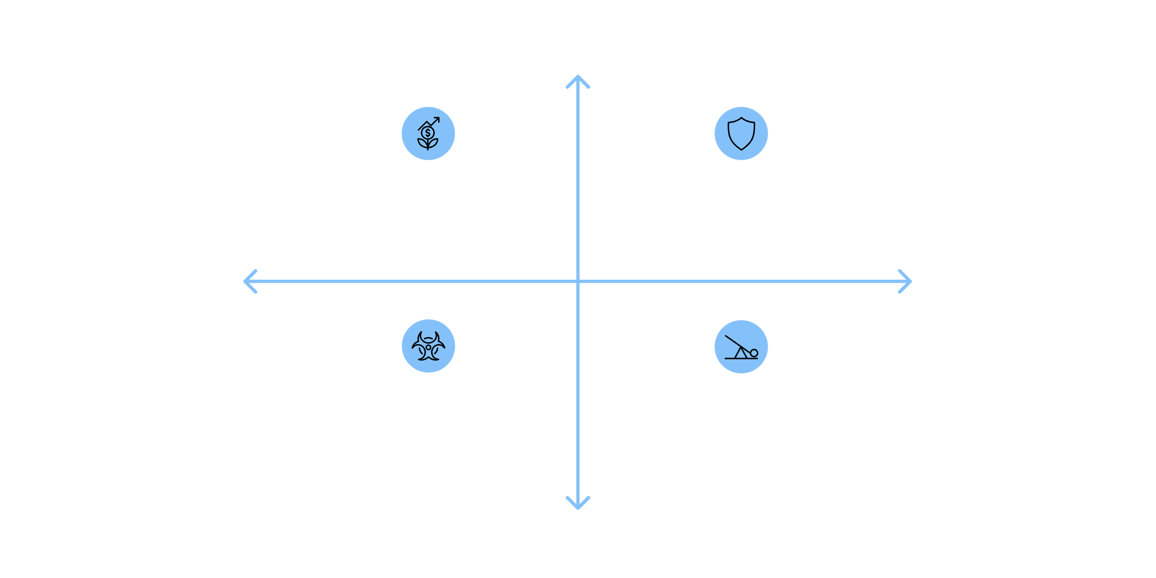




TOWS Matrix: From Analysis to Action
The TOWS Matrix takes the SWOT analysis a step further by helping organizations develop strategies that align internal and external factors. It identifies four types of strategic approaches:
Strengths
SO: Use strengths to seize opportunities
ST: Use strengths to mitigate threats
Opportunities
Threats
WO: Improve weaknesses to exploit opportunities
WT: Minimise weaknesses to avoid opportunities
Weaknesses
By systematically exploring these intersections, the TOWS Matrix helps managers formulate proactive strategies to leverage advantages, overcome limitations, and mitigate risks, turning analysis into concrete action plans.

Slide 25

Mini Case Study: "ByteBite" Food Delivery
Background: ByteBite is a well-established local food delivery startup, known for its extensive restaurant network and reliable service. They operate primarily through their mobile app and website, offering a commission-based model to restaurants.
The Challenge: Recently, major tech companies have entered the food delivery market with large investment, offering drone delivery in select areas and AI-powaered personalized meal recommendations. Simultaneously, local restaurants are pushing back on high commission rates, and a new privacy regulation is limiting data collection for marketing.
Identify: What are 2-3 key Strengths, Weaknesses, Opportunities, and Threats for ByteBite?
Formulate: Propose at least one SO, ST, WO, and WT strategy for ByteBite to address these challenges and opportunities.

Slide 26
Conclusion & Discussion
The Strategic Journey:
01
02
Business Environment Analysis
Recognizing VUCA Conditions
Understanding the macro (PESTLE) and micro factors.
Identifying the volatility, uncertainty, complexity, and ambiguity created by environmental shifts.
03
04
SWOT Analysis
TOWS Matrix Development
Systematic assessment of internal strengths/weaknesses and external opportunities/threats.
Translating analysis into actionable strategies (SO, ST, WO, WT).
Ultimately, managers convert raw environmental data into strategic intelligence, enabling them to make informed decisions and transform challenges into competitive advantages.
Q&A / Reflection
What are the key takeaways you will apply in your future business thinking?

Slide 27
